Slide 1
Engineering Management
Energy Management System ISO 50001:2018
Lecture 43,44,45

Slide 2
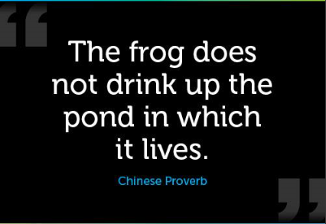

Slide 3
WHAT IS ISO?????
ISO (International Organization for Standardization) is a worldwide federation of national standards bodies. ISO is a nongovernmental organization that comprises standards bodies from more than 160 countries, with one standards body representing each member country.

Slide 4
Energy Management
“The judicious and effective use of energy to maximize profits (minimize costs) and enhance competitive positions”
“The strategy of adjusting and optimizing energy, using systems and procedures so as to reduce energy requirements per unit of output while holding constant or reducing total costs of producing the output from these systems”

Slide 5
Objectives of Energy Management
To achieve and maintain optimum energy procurement and utilization, throughout the organization.
To minimize energy costs / waste without affecting production & quality.
To reduce import dependency.
To enhance energy security, economic competitiveness, and environmental quality.

Slide 6
There are several changes that have been made to the 2011 version to bring the standard in line with the needs and changes of today’s business environments.
INTRODCUTION TO EnMS ISO 50001:2018
The updated version of the Energy Management System ISO 50001 was published on the 21st August 2018. The standard is a framework that sets out a systematic approach for the improvement of energy performance within an organization.

Slide 7
INTRODCUTION TO EnMS ISO 50001:2018
Users familiar with ISO 50001:2011 will recognize that most of the requirements of ISO 50001:2011 will be continued in ISO 50001:2018. This is particularly the case for the more energy specific elements and requirements, which is not a surprise as this was one of the stated objectives for the revision.
There are some new and revised requirements, most of them due changes introduced by the ‘high level structure’. These include:

Slide 8
Context of the organization
An organization shall determine external and internal issues relevant to its purpose
and that affect its
ability to achieve the intended outcomes of its energy management system (EnMS) and improve its energy performance.
In other words high level understanding of influential factors affecting, negatively or positively, energy performance and the EnMS of the organization.
Leadership
Clause 5.1 now includes new demands to actively engage and demonstrate senior management leadership for the effectiveness of the energy management system and its expected outcome of improved energy performance.

Slide 9
Risk and opportunity management
Clause 6.1 requires an organization to determine, and where necessary, take action to address any risks or opportunities that may impact (either positively or negatively) the ability of the management system to deliver its intended results.
Competence
The revised standard now requires an organization to determine the necessary competence of people doing work under its control and that affects its energy performance and EnMS. In addition it must evaluate effectiveness of those actions taken to acquire the necessary competence.

Slide 10
Operational planning and control
Change has to be fully controlled and the impacts and consequences of unforeseen changes have to be reviewed. Outsourced significant energy uses or processes related to them have to be controlled.
Energy review
The process related to significant energy uses (SEU) has been amended to make a more logic “flow”. So now, for each SEU the relevant variables, current energy performance and identification of persons that influence or affect that SEU must be defined.

Slide 11
Benefits of EnMS

Slide 12
INTERNAL
Reduce energy costs.
Improve competitiveness.
Reduce service and maintenance costs.
Improve production and working conditions.
Improve operational safety.
Costs transparency.
Improve corporate image.

Slide 13
EXTERNAL
Regulatory compliance.
Market demand for green/ environmental related policies.
Certifications and standards requirements.
Government funding.
Uncertainty and increase in energy prices.

Slide 14
Developing Energy Conversation & Management Culture

Slide 15
Why Energy Management?
Big Cost for energy intensive companies
Corporate Social Responsibility
Non Energy Benefits – noise, pollution, Health & Safety, Quality, maintenance
Requirements from customers environmental compliance (IKEA, Walmart, Apple, Google etc.)

Slide 16
Traditional ‘Ad hoc’ approach to energy management…
Costs high
= Audit
Costs high again:
Where’s that last audit?
Waste cutting, some investment
Costs
Here we go again!
+5%
0
-5%
Under control.
-10%
-15%
-20%
-25%
0
Years
5

Slide 17
Structured Approach to Energy Management
Senior management commit to programme
Costs
Initial savings
sustained
+5%
0
Housekeeping first – then investment
-5%
-10%
Becomes company
culture
-15%
-20%
-25%
Investment
0
Years
3

Slide 18
3 Aspects Interlinked
Organisational
People
Technical

Slide 19
Organisational
Management commitment, resources, planning
People
Develop an energy efficiency culture
Technical
Understanding your energy usage and how to control it
Balance all 3 for a successful outcome

Slide 20
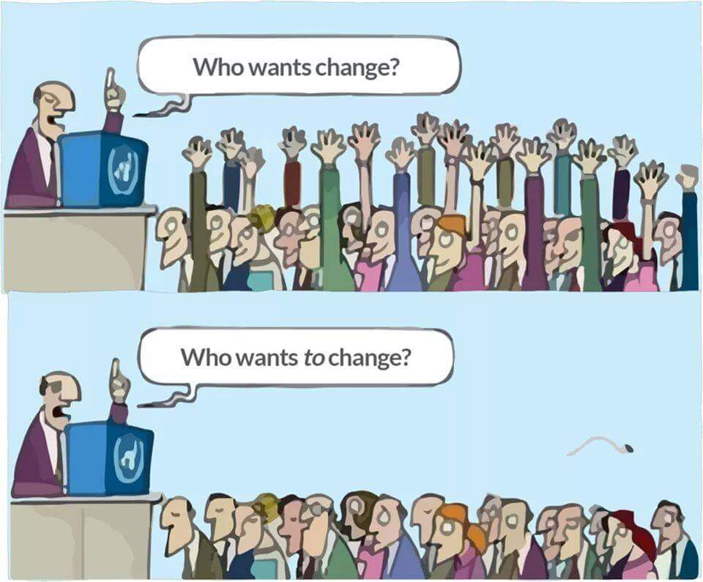
We need to CHANGE!

Slide 21
‘Culture is what people do when no-one is looking’
Herb Kelleher, Chairman, Southwest Airlines

Slide 22
How culture is created
Actions & Behaviour of Leaders
What Leaders Pay Attention To
Leaders
Culture
What Gets Rewarded and What Gets Punished
Allocation of Attention and Resources

Slide 23
Commitment
There’s a difference between Interest and Commitment:
When you’re interested in doing something you do it only when it’s convenient
When you’re committed to something, you accept no excuses, only results
- Kenneth Blanchard.

Slide 24
Origin of ISO50001
PLAN
Plan what you need to do
DO
Do it
CHECK
Check that it works
ACT
Act to improve performance
Came from UNIDO prompting ISO to develop international standard to achieve for energy. what ISO9001 did for Quality

Slide 25
5 Steps to EnMS
PLAN
Plan what you need to do
DO
Do it
CHECK
Check that it works
ACT
Act to improve performance
Step 1 – Management
Commitment
Step 2 – Plan
Step 3 – Do
Step 4 – Check
Step 5 - Act

Slide 26
Step 1 – Management Commitment
Develop and publish Energy Policy – stating senior managements commitment to managing energy
Define Scope & Boundaries of the EnMS (what is included?)
Appoint cross functional team linked to Senior Management team
Provide resources – mainly human but also capital where it makes business sense
Monitor progress regularly
Make decisions as required
Notes:
Bob to give example on team from China

Slide 27
Step 2 - PLAN
Analyse Energy consumption
What energy sources & how much (kWh & $)
Consumption and cost trends - past and future
What drives energy consumption up & down?
Energy Performance Indicators (EnPIs)
What are the Significant Energy Uses (SEUs)
For SEUs:
Identify critical operational and maintenance parameters
Identify critical people
Identify Opportunities for Improvement
Set Objectives, Targets and Action Plans for performance improvement

Slide 28
Step 3 - DO
Implement Awareness & Behavioural Change initiatives
Implement Training Plans focussed on SEUs
Develop necessary Documentation – Procedures & Records
Implement Action Plans
Monitor Progress via EnPIs
Address any Legal compliance issues relating to Energy
Consider Energy Efficiency in Capital Investment decisions - new processes, buildings etc.
Consider Energy Efficiency in Procurement decisions for all equipment & services affecting energy consumption

Slide 29
Step 4 – CHECK
Continual Improvement
Energy Policy
Are we doing what we said we would do?
Check on implementation of action plans, training plans etc.
Does it comply with the standard?
Check for non conformances against ISO50001 via internal audits
Is it working?
Check whether the Action Plans are delivering the planned savings
Check whether EnPIs are showing improvement
Carry out formal Management Review
Planning
Management Review
Implementation & Operation
Checking & Corrective Action
Internal Audit
Monitor & Measure
Corrective & Preventive Action

Slide 30
Step 5 - ACT
As per results of checking phase – correct what’s wrong – prevent it happening in the future
Continual improvement – develop new action plans and targets, identify new opportunities

Slide 31
